Slide 1
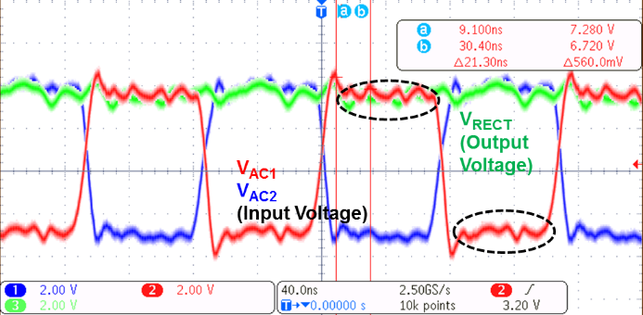
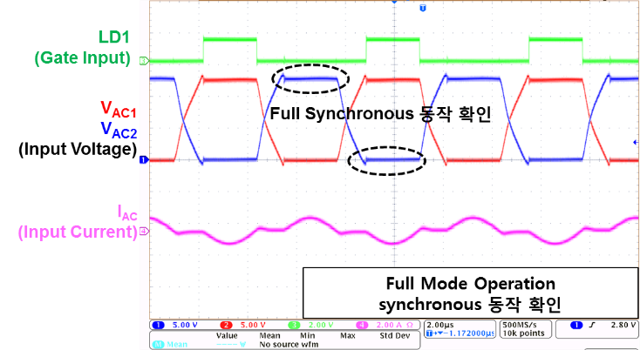
Design of RF Band Design of Quadruple-Mode Active Rectifier for Wireless Charging System of IoT/Wearable Devices
Sang Rim Back, Jae Bin Kim, Sang-Gyu Jeon, Tae Young Yoon and Kang-Yoon Lee
Department of Electrical and Computer Engineering, Sungkyunkwan Univ.
backsr411@skku.edu
Introduction
Measurement Result
Technologies such as smartphones, wearable devices, and the IoT require rapid wireless charging system.
The proposed Active Rectifier operates in Quadruple-Mode including magnetic induction(WPC/PMA), magnetic resonance(A4WP), and MST functions.
This study proposes a Quadruple-Mode Active Rectifier that integrated four functions into one IC.
Fig 2. WPC/PMA standard Mode measurement Results of Proposed Quadruple-mode Active Rectifier
Proposed Structure
Fig 3. A4WP standard mode measurement Results of Proposed Quadruple-mode Active Rectifier.
Fig 2. shows fully synchronous operation and IAC flow without leakage current was confirmed through measurement. In addition, it was confirmed that the gate signal is also turned on for normal timing.
Fig 3. shows the measurement results of the proposed Quadruple-Mode Active Rectifier in A4WP standard mode. Both low side and high side are fully synchronous and IAC flow without leakage current.
As it operates in the high frequency band of 6.78 MHz, the waveform is waver compared to WPC / PMA mode.
Fig 1. Top Block Diagram of the proposed Quadruple-mode Active Rectifier
Reduced losses the frequency of the WPC/PMA method and the A4WP method is used to select each method through the frequency detection.
In order to prevent leakage current through the MOSFETs, the gate signal of the MOSFET is generated using the Switchable Zero Voltage and Current Sensing(SZVCS) technique in the WPC/PMA standard mode.
The digitally controlled delayed adjustment in the A4WP standard mode.
In MST mode, low power MST technique is used to minimize current.
Conclusion
We proposed a Quadruple-Mode Active Rectifier that supports four wireless charging standard modes with one single chip.
The layout size is 1340$×$2610$μm^{2}$ and the efficiency is 96% up to 15W a 0.18um BCD process was used.
The chip fabrication and EDA tool were supported by the IC Design Education Center(IDEC), Korea.

